Slide 1
Long/Short Global Macro Strategies with Target Betas using the 3-Factor Model
FE630: Portfolio Theory & Applications
Papa Momar Ndiaye
Theo Dimitrasopoulos - Msc. FE ‘21
Yuki Homma - MSc - FE ‘21

Slide 2
Agenda
French Fama 3-Factor Model
Investment Universe
Investment Strategy
Performance & Risk Metrics
Results & Discussion

Slide 3
Fama French 3-Factor Model
CAPM
Anomalies:
Size effect
Leverage
book-to-market ratio
E/P(inverse of P/E)
French Fama 3-Factor Model

Slide 4
Investment Universe
Investment Horizon
CurrencyShares Euro Trust (FXE)
iShares MSCI Japan Index (EWJ)
SPDR GOLD Trust (GLD)
Powershares NAASDAQ-100 Trust (QQQ)
SPDR S&P 500 (SPY)*
iShares Lehman Short Treasury Bond (SHV)
PowerShares DB Agriculture Fund (DBA)
United States Oil Fund LP (USO)
SPDR S&P Biontech (XBI)
iShares S&P Latin America 40 Index (ILF)
iShares MSCI Pacific ex-Japan Index Fund (EPP)
SPDR DJ Euro Stoxx 50 (FEZ)
* SPY is the analysis benchmark
March 22, 2007 - October 30, 2020
Market Regimes
Housing Crisis: March 3, 2008 - September 10, 2010
COVID-19 Pandemic: March 9, 2020 - Present
Analysis Periods
March 22, 2007 - March 3, 2008
March 3, 2008 - September 10, 2010 (Housing Crisis)
September 10, 2010 - January 1, 2015
January 1, 2015 - March 9, 2020
March 9, 2020 - Present (COVID-19 Pandemic)

Slide 5
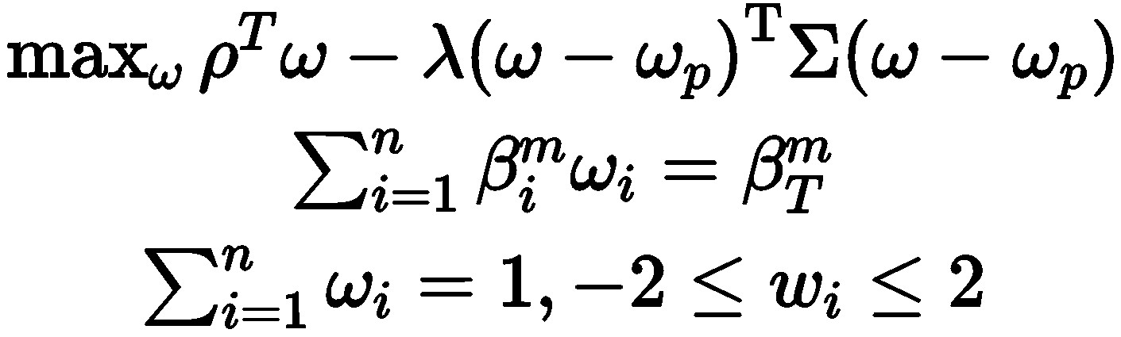
Investment Strategy
Lookbacks:
Target Betas
S_{60}^{60}
S_{120}^{60}
S_{60}^{90}
S_{120}^{90}
S_{60}^{120}
S_{120}^{120}
β^{m}_{T} = -1.0
β^{m}_{T} = -0.5
β^{m}_{T} = 0.5
β^{m}_{T} = 1.0
β^{m}_{T} = 1.5
β^{m}_{T} = 2.0
Optimization Function:

Slide 6
Performance & Risk Metrics
Performance
Risk
Cumulative Return
Annual Arithmetic/Geometric Mean
Annual Min Return
Max 10-day Drawdown
Sharpe Ratio
Skew
Kurtosis
Volatility
Daily VaR
Annual VaR
Modified VaR
Annual CVaR
Skewness
Kurtosis

Slide 7
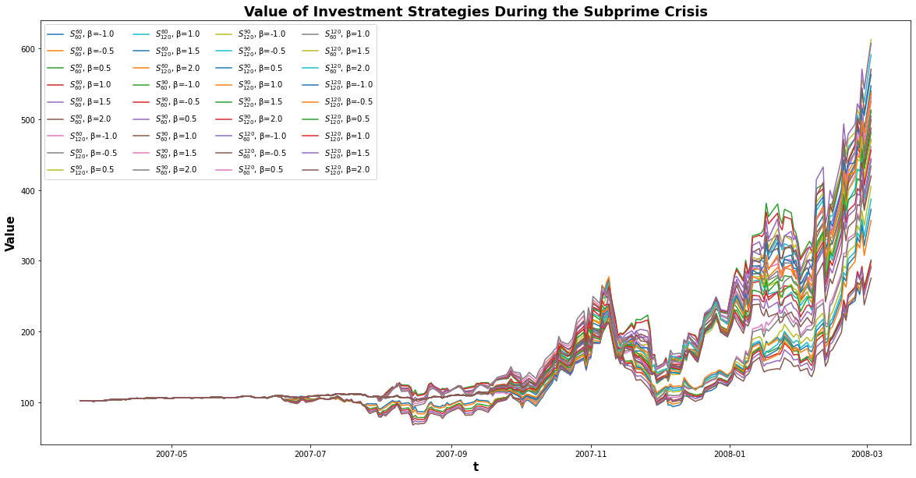
Before

Slide 8
 | $S^{120}_{120}$ | $S^{120}_{120}$ | $S^{120}_{120}$ | $S^{120}_{120}$ | SPY
 | β = 0.5 | β = 1.0 | β = 1.5 | β = 2.0
Cumulative Return (Annual) | 5.176351992 | 4.892516087 | 4.744144629 | 4.485051749 | 0.964412341
Arithmetic Mean Return (Annual) | 1.891994238 | 1.836191775 | 1.813920231 | 1.768169502 | -0.02135688757
Geometric Mean Return (Annual) | 1.649518563 | 1.592759023 | 1.561769172 | 1.505263562 | -0.03623371019
Minimum Return (Annual) | -52.35153712 | -54.72030433 | -57.10126549 | -59.46562173 | -7.408435644
Max 10-day Drawdown | -0.2843867236 | -0.2708501173 | -0.2627068501 | -0.2609310004 | -0.07481043119
Volatility | 0.6983530589 | 0.6989272858 | 0.7108232901 | 0.7247090876 | 0.172296237
Sharpe Ratio (Annual) | 2.623306671 | 2.541311251 | 2.467449021 | 2.357041648 | -0.4721919002
Kurtosis (Annual) | 6.255009432 | 6.642518352 | 6.892797617 | 6.767124314 | 0.4724578531
Skew (Annual) | 0.23339572 | 0.1792846962 | 0.1522951731 | 0.06608290081 | -0.2775126259
mVaR (Annual) | -89.38283429 | -90.37688512 | -92.45191576 | -96.75683945 | -29.64524056
VaR (Daily) | -6.50814666 | -6.536441309 | -6.669103676 | -6.831857471 | -1.800934954
VaR (Annual) | -102.902834 | -103.3502116 | -105.4477878 | -108.0211513 | -28.47528186
CVaR (Annual) | -147.2696124 | -148.2404085 | -152.2498555 | -157.5936754 | -40.17965124

Slide 9
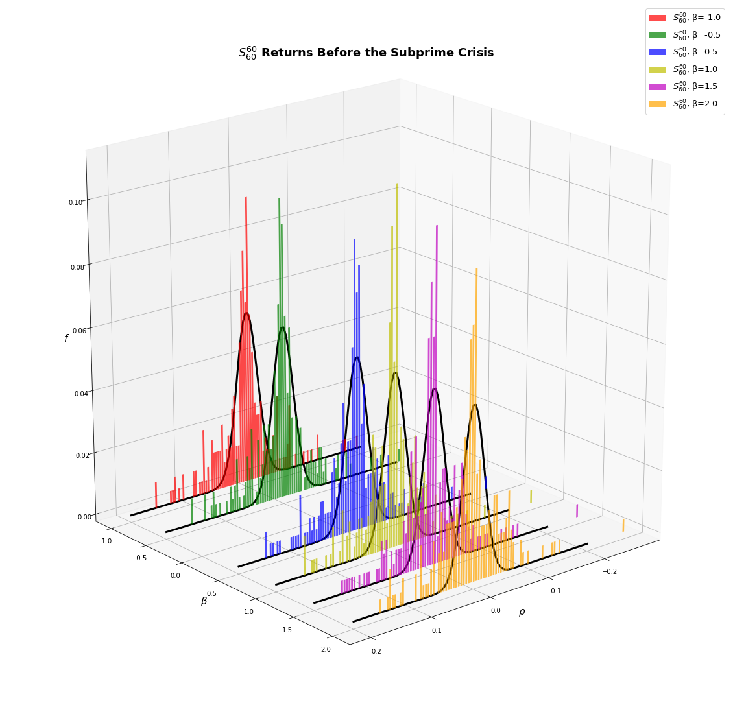
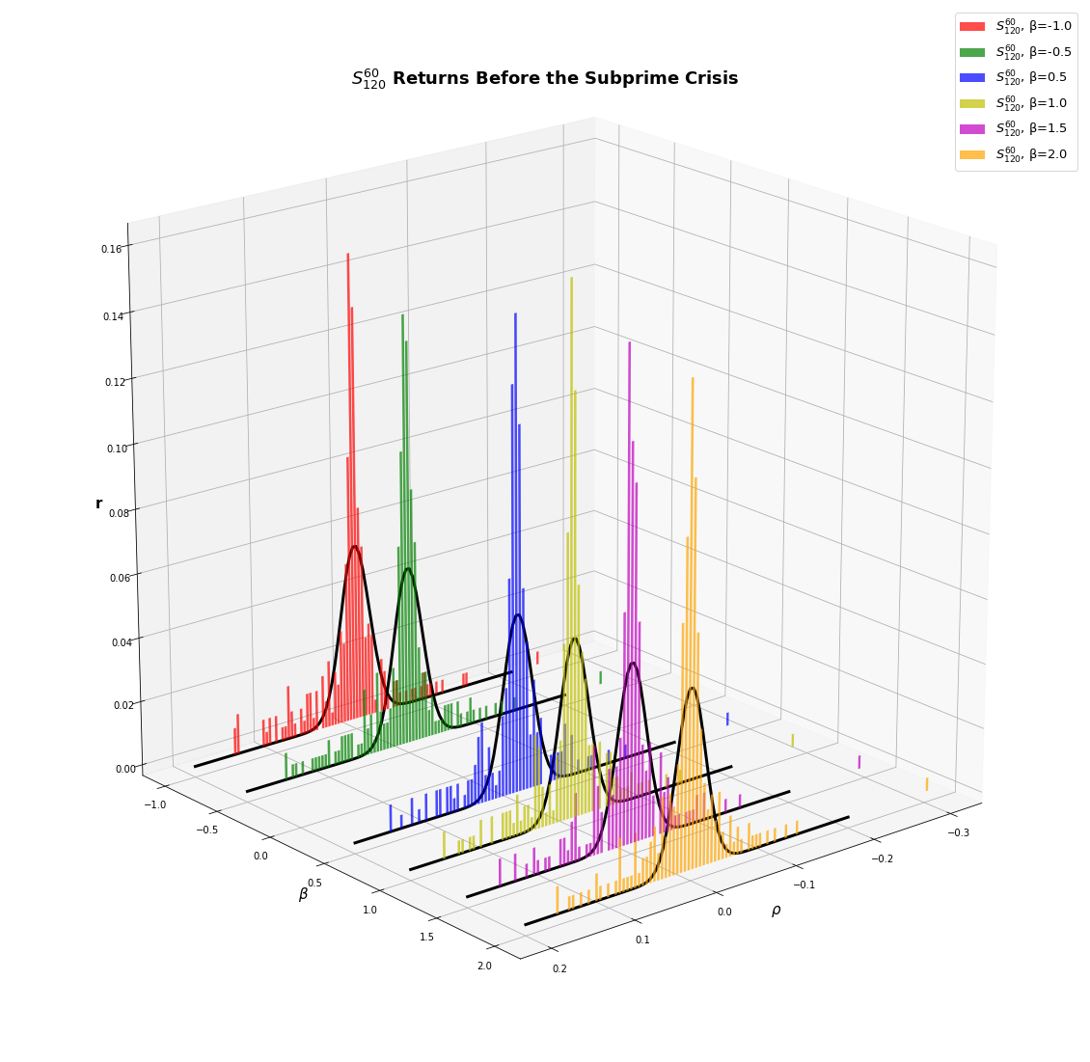
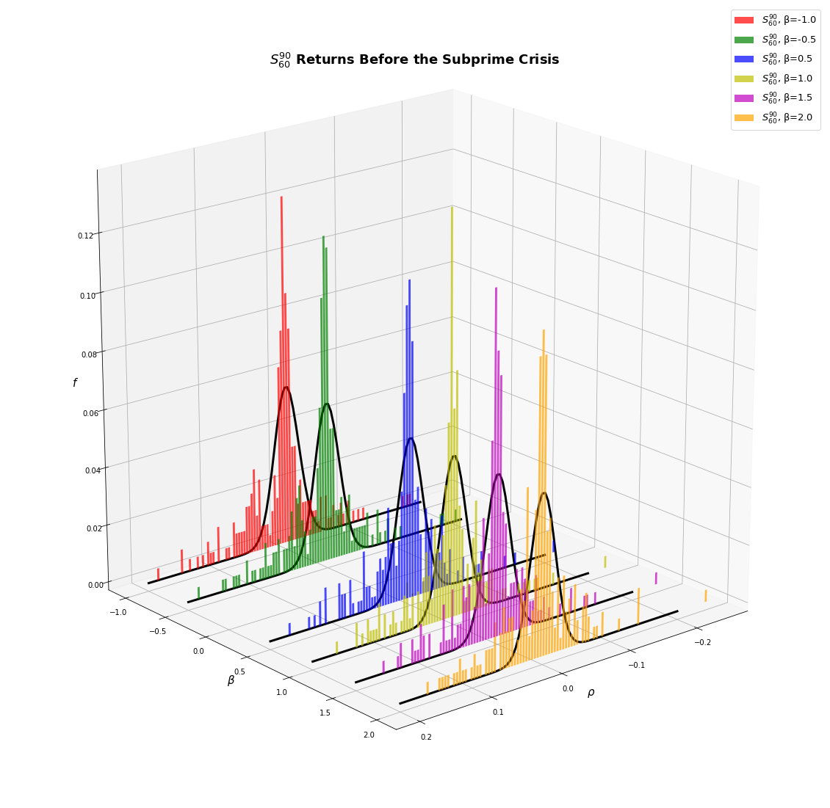
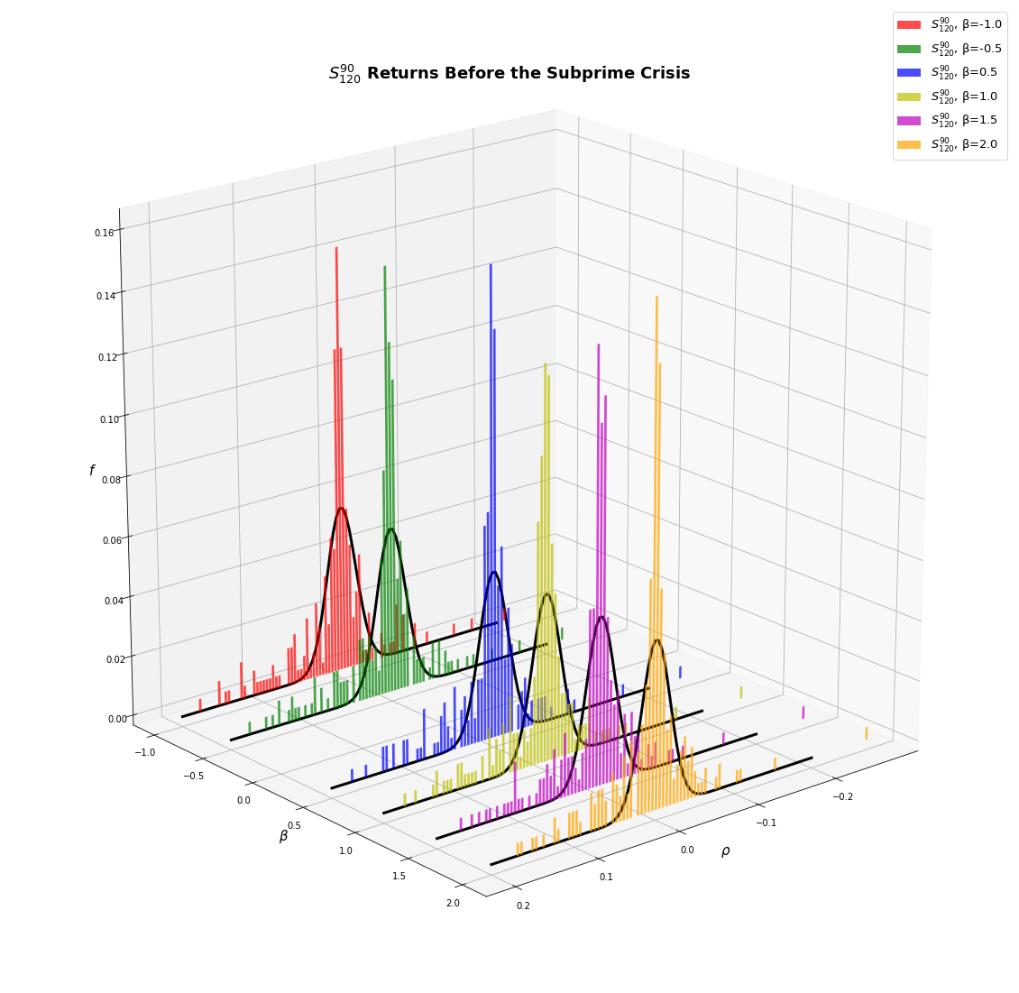
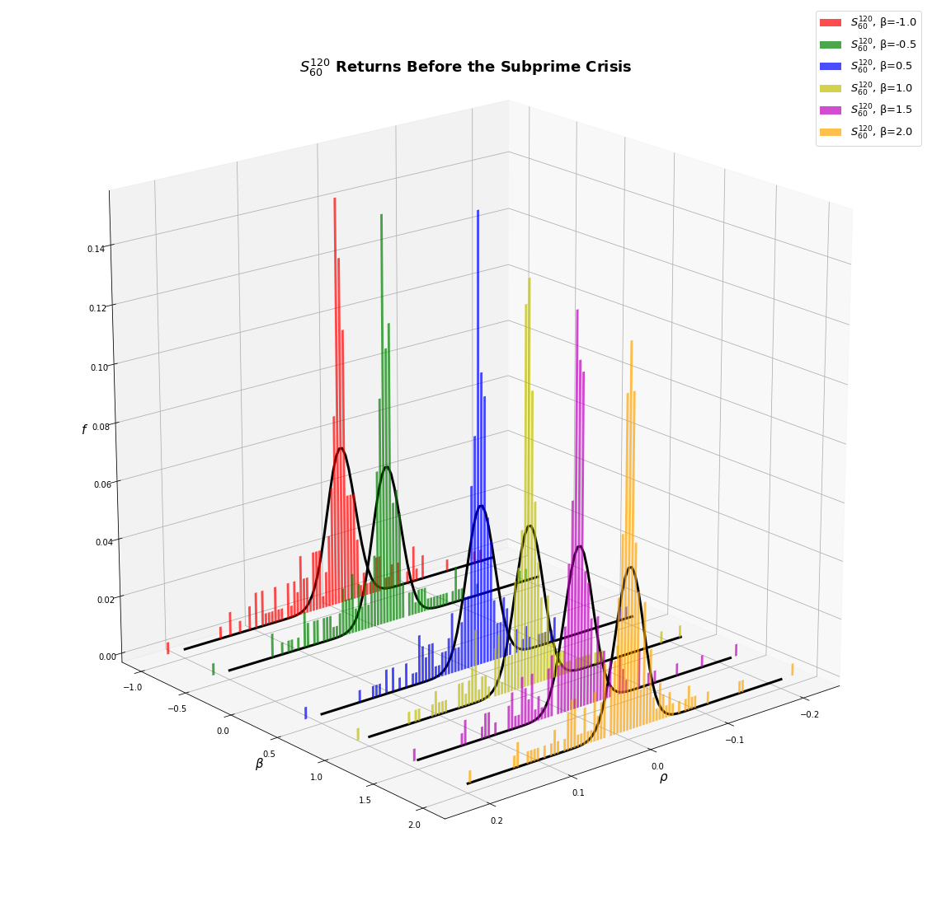
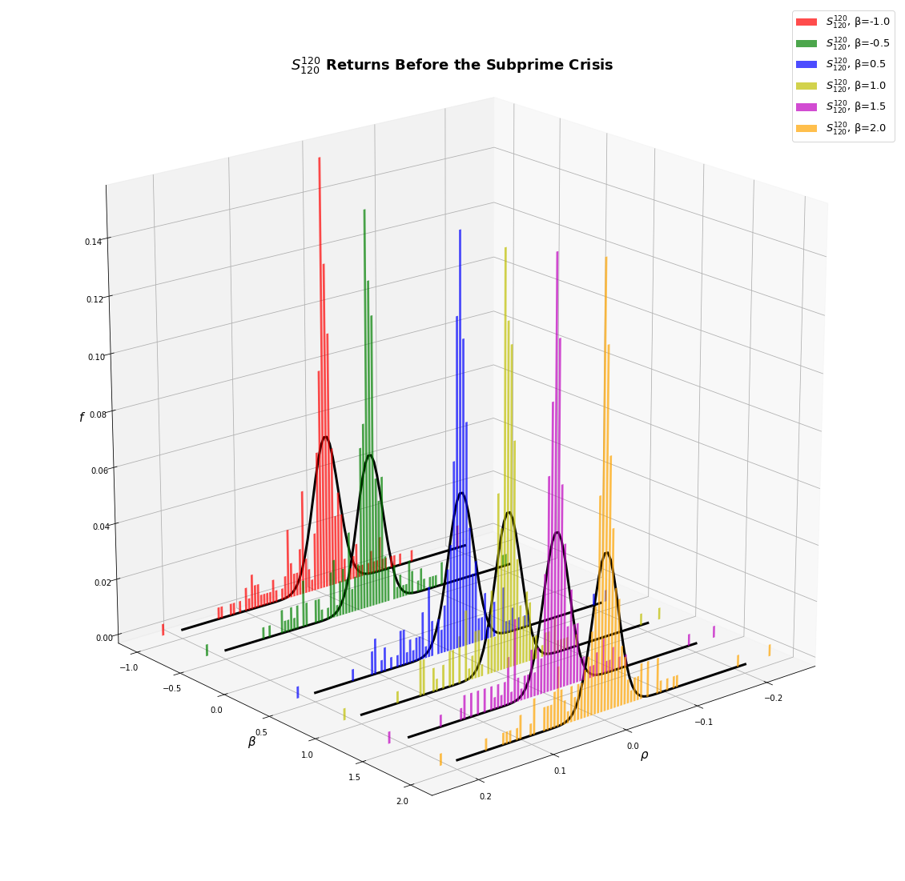

Slide 10
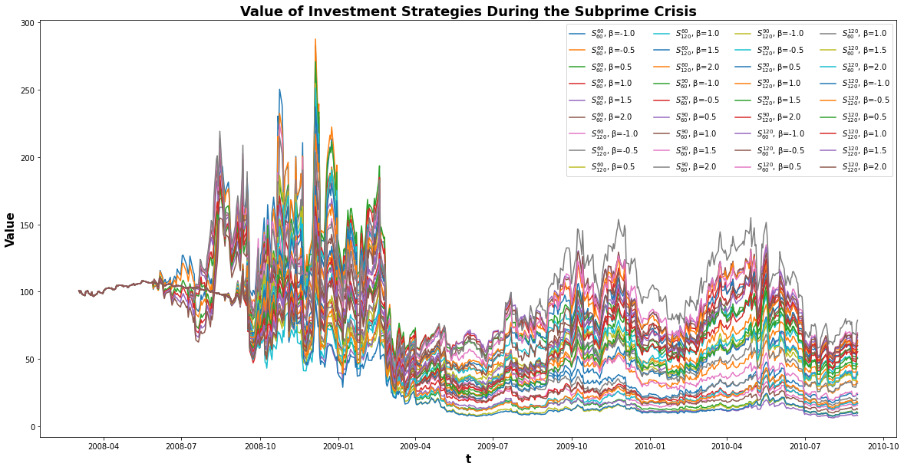

Slide 11
 | S^{120}_{120} | S^{120}_{120} | S^{120}_{120} | S^{120}_{120} | SPY
 | β = 0.5 | β = 1.0 | β = 1.5 | β = 2.0
Cumulative Return (Annual) | 0.73646339 | 0.816788729 | 0.855882611 | 0.8603305972 | 0.940681933
Arithmetic Mean Return (Annual) | 0.3579855855 | 0.4564976012 | 0.5157330126 | 0.5564083247 | -0.009393771313
Geometric Mean Return (Annual) | -0.3057086843 | -0.2022929221 | -0.1555736226 | -0.1503932938 | -0.06114272804
Minimum Return (Annual) | -84.19510194 | -81.22947619 | -77.24028534 | -79.11109333 | -24.6119145
Max 10-day Drawdown | -0.6032860645 | -0.6161731668 | -0.6302079224 | -0.6452691786 | -0.2494830051
Volatility | 1.133071613 | 1.129775095 | 1.141422733 | 1.172451833 | 0.322236709
Sharpe Ratio (Annual) | 0.2629891899 | 0.3509526833 | 0.3992675103 | 0.4233933633 | -0.215350298
Kurtosis (Annual) | 3.642023535 | 3.332574593 | 3.091148133 | 2.950269252 | 7.822812725
Skew (Annual) | -0.3745675113 | -0.3717771494 | -0.3459306225 | -0.2886996979 | 0.3942604103
mVaR (Annual) | -187.5472831 | -186.9923502 | -188.332592 | -191.7896885 | -44.27004428
VaR (Daily) | -11.64411322 | -11.57041485 | -11.66789068 | -11.97441528 | -3.355975603
VaR (Annual) | -184.1095955 | -182.944322 | -184.4855502 | -189.3321297 | -53.06263339
CVaR (Annual) | -290.9369938 | -288.0490885 | -287.0504959 | -290.1420382 | -77.65164134

Slide 12
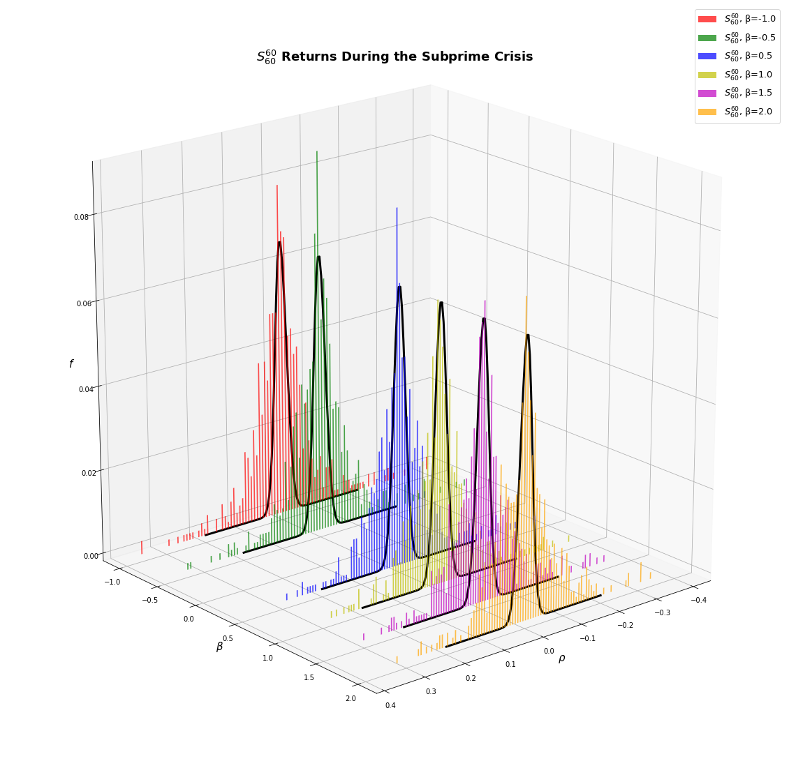
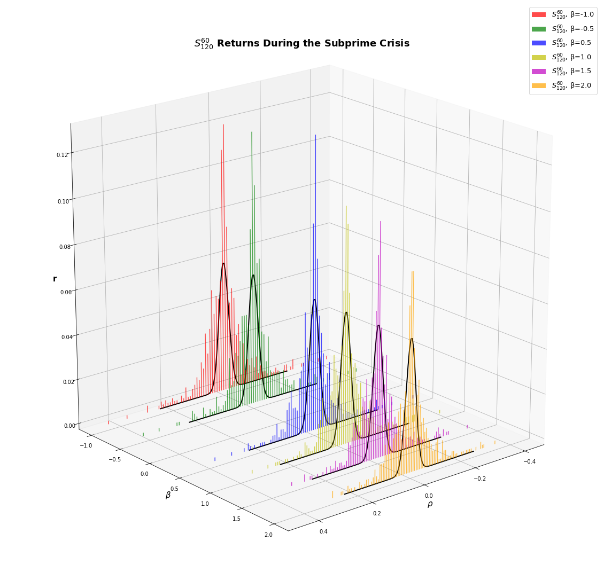
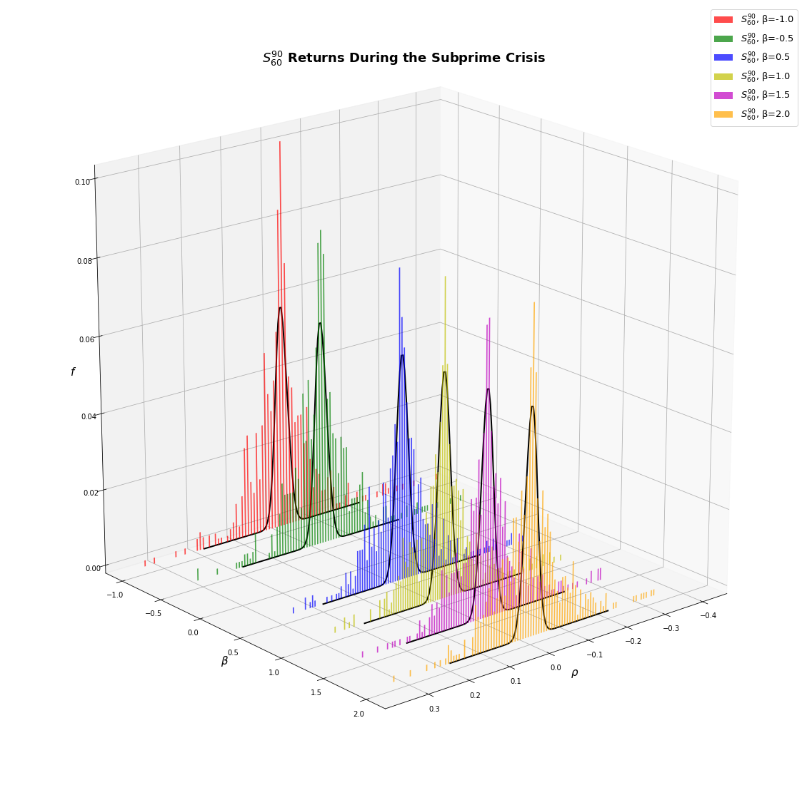
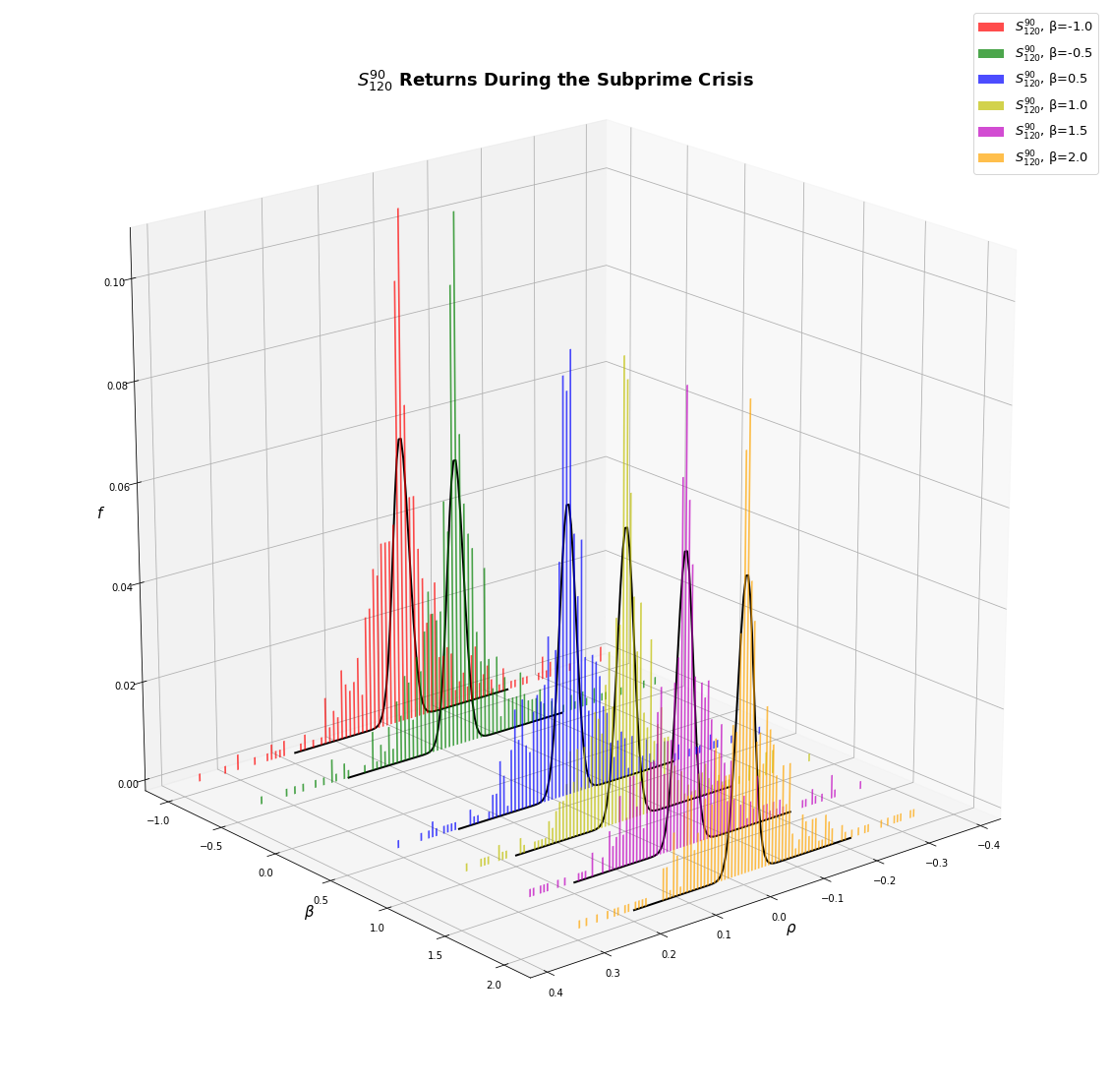

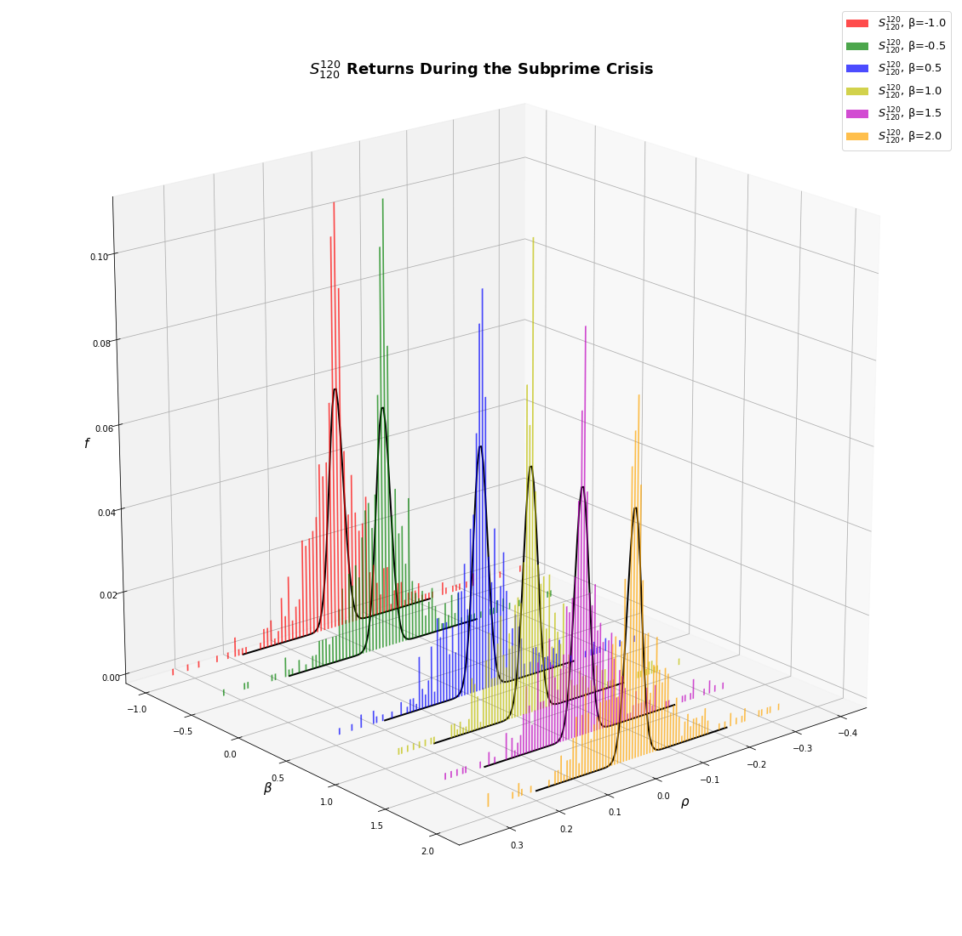

Slide 13
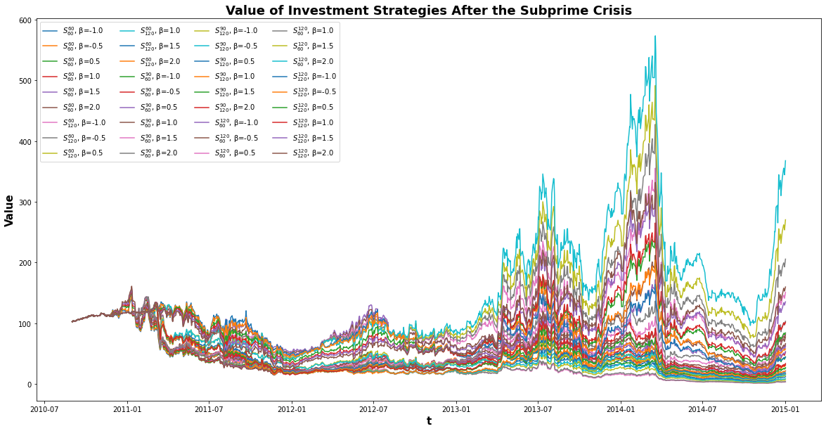

Slide 14
 | S^{60}_{60} | S^{60}_{60} | S^{60}_{60} | S^{60}_{60} | S^{60}_{60} | S^{60}_{60}
 | β = -1.0 | β = -0.5 | β = 0.5 | β = 1.0 | β = 1.5 | β = 2.0
Cumulative Return (Annual) | 0.7038249566 | 0.7667284917 | 0.8320816025 | 0.8613093203 | 0.9033088004 | 0.9426963675
Arithmetic Mean Return (Annual) | -0.006903515592 | 0.07101297157 | 0.1525617143 | 0.1922896859 | 0.2512071147 | 0.3108289568
Geometric Mean Return (Annual) | -0.3509789915 | -0.2654814669 | -0.1837571965 | -0.149257009 | -0.1016701332 | -0.05900406982
Minimum Return (Annual) | -58.3098973 | -57.61298546 | -56.75884551 | -56.50015281 | -58.41400425 | -61.24821035
Max 10-day Drawdown | -0.5113769333 | -0.5017049687 | -0.4816313596 | -0.4710039311 | -0.4615612453 | -0.4536859255
Volatility | 0.8268760054 | 0.8174668964 | 0.8164393417 | 0.8224658049 | 0.8359259639 | 0.8558305531
Sharpe Ratio (Annual) | -0.08091118276 | 0.01347207039 | 0.1133724327 | 0.160845211 | 0.2287369013 | 0.2930824985
Kurtosis (Annual) | 2.62037538 | 2.390598161 | 2.060063734 | 1.871975271 | 1.722667336 | 1.673768117
Skew (Annual) | 0.01426702133 | -0.02485490134 | -0.1038542311 | -0.1316656605 | -0.1403161439 | -0.1335467279
mVaR (Annual) | -131.3443914 | -130.6450286 | -132.3268987 | -134.0117951 | -136.3059907 | -139.1351318
VaR (Daily) | -8.60472583 | -8.475676577 | -8.432367462 | -8.479169375 | -8.595628004 | -8.778846067
VaR (Annual) | -136.0526613 | -134.0122135 | -133.3274362 | -134.0674395 | -135.9088121 | -138.805744
CVaR (Annual) | -187.5621103 | -186.7664879 | -188.8864708 | -189.8282298 | -191.3275242 | -194.2755738

Slide 16
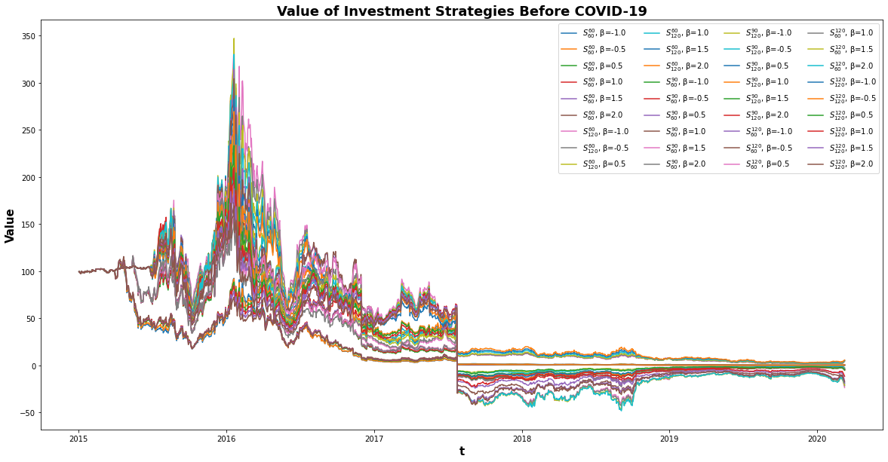

Slide 17
 | S^{60}_{120} | S^{60}_{120} | S^{60}_{120} | S^{60}_{120} | S^{60}_{120}
 | β = -0.5 | β = 0.5 | β = 1.0 | β = 1.5 | β = 2.0
Cumulative Return (Annual) | 0.5553667608 | 0.558071371 | 0.5679071643 | 0.5734710604 | 0.5769060634
Arithmetic Mean Return (Annual) | -0.1637589279 | -0.1458532662 | -0.131796943 | -0.1188306911 | -0.1069565543
Geometric Mean Return (Annual) | -0.5874353096 | -0.5825885444 | -0.5651575463 | -0.555429885 | -0.5494711043
Minimum Return (Annual) | -142.6342431 | -161.3001361 | -156.9348675 | -154.4640715 | -149.6649849
Max 10-day Drawdown | -0.6462274739 | -0.7081028043 | -0.6931496916 | -0.684532362 | -0.6684441685
Volatility | 0.9021101545 | 0.8977719883 | 0.8968152818 | 0.9014297998 | 0.9108438979
Sharpe Ratio (Annual) | -0.2480394737 | -0.2292934831 | -0.2138644901 | -0.1983855993 | -0.183298757
Kurtosis (Annual) | 13.77176559 | 15.54847366 | 13.54356336 | 12.1542404 | 10.27208515
Skew (Annual) | -0.1363561228 | -0.8161371754 | -0.8338865528 | -0.8533796185 | -0.7982940149
mVaR (Annual) | -127.8128603 | -140.1270254 | -143.9214955 | -147.5469313 | -151.1939907
VaR (Daily) | -9.450126422 | -9.397834354 | -9.382259238 | -9.42507742 | -9.518262323
VaR (Annual) | -149.4196183 | -148.5928082 | -148.346544 | -149.0235588 | -150.4969415
CVaR (Annual) | -201.4706347 | -203.1483457 | -205.2004395 | -208.2543362 | -212.405187

Slide 18
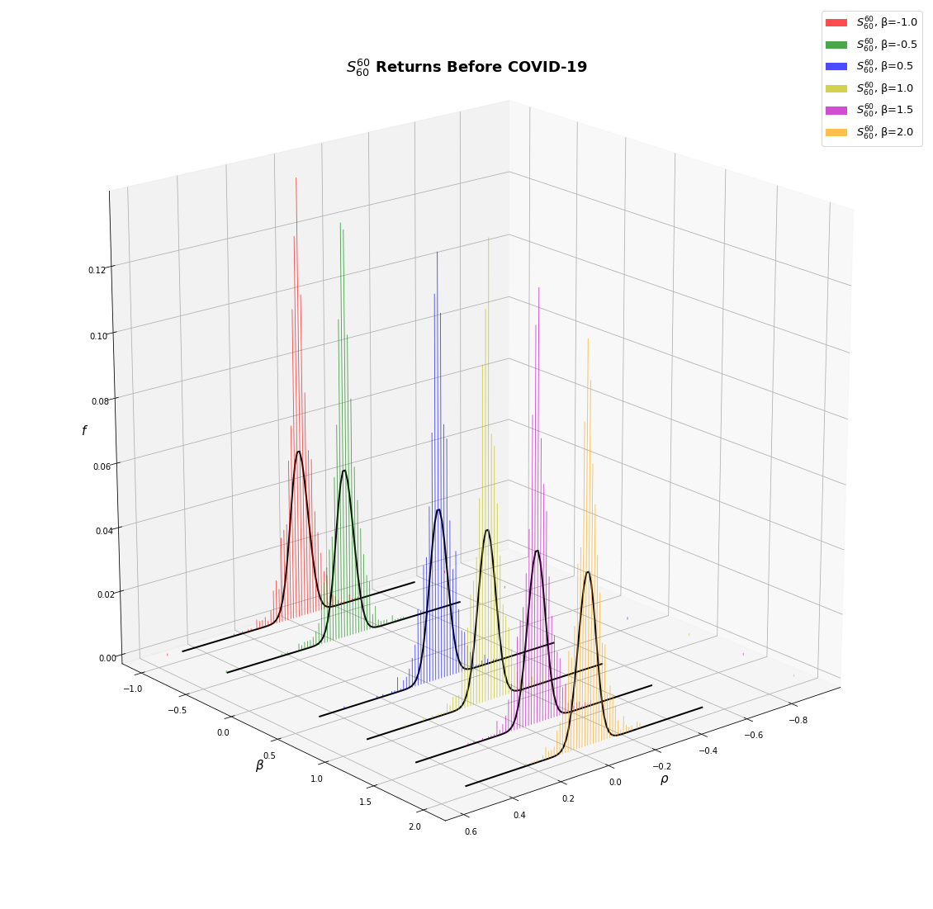
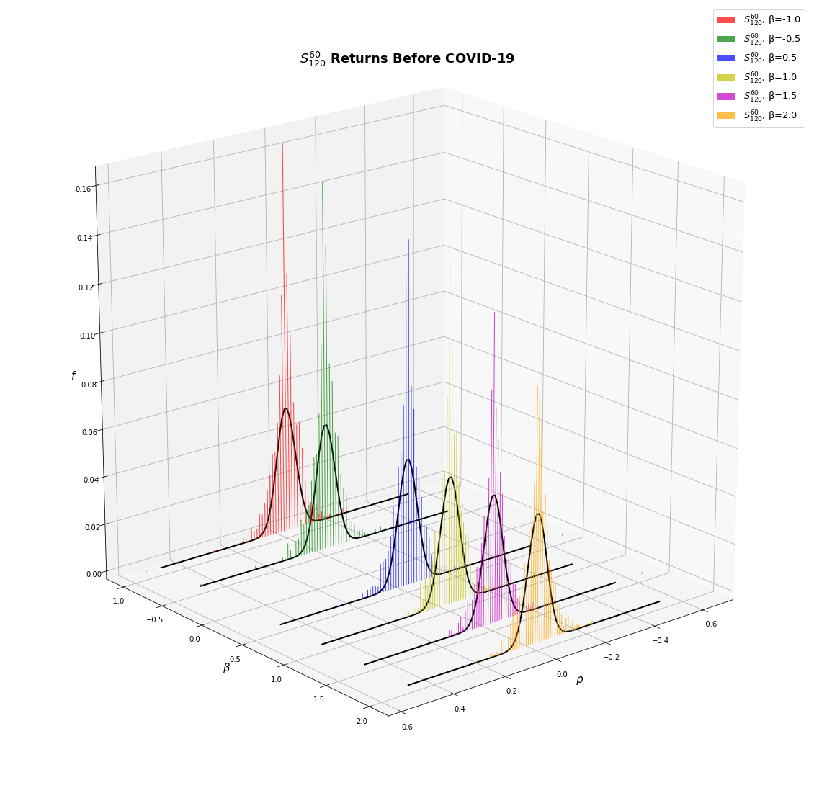
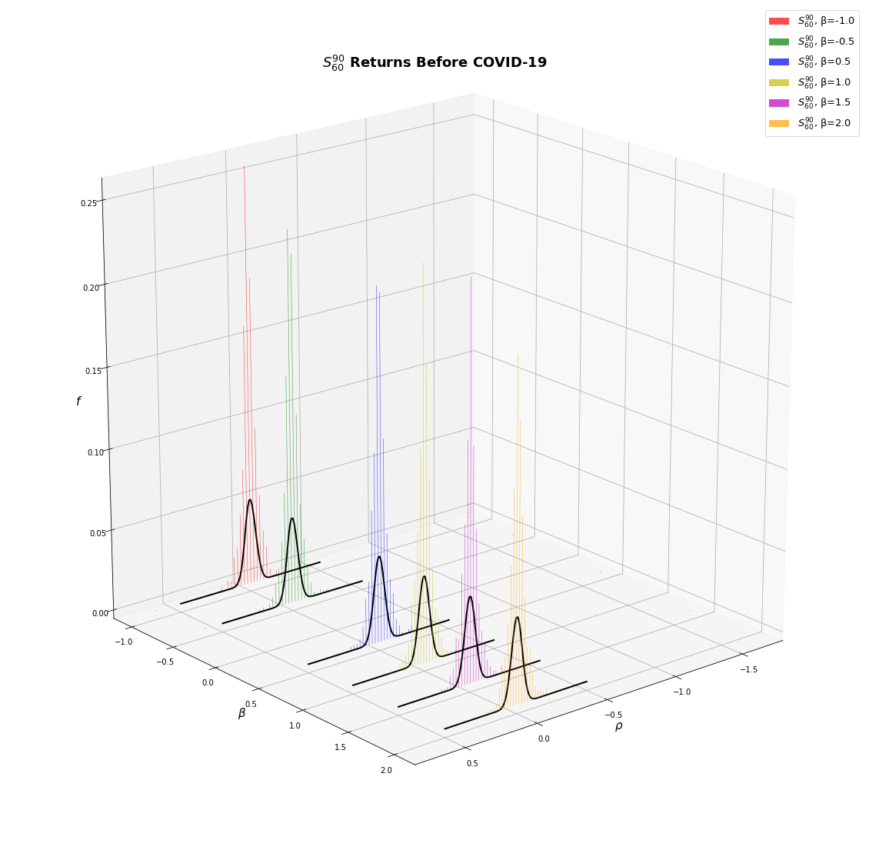
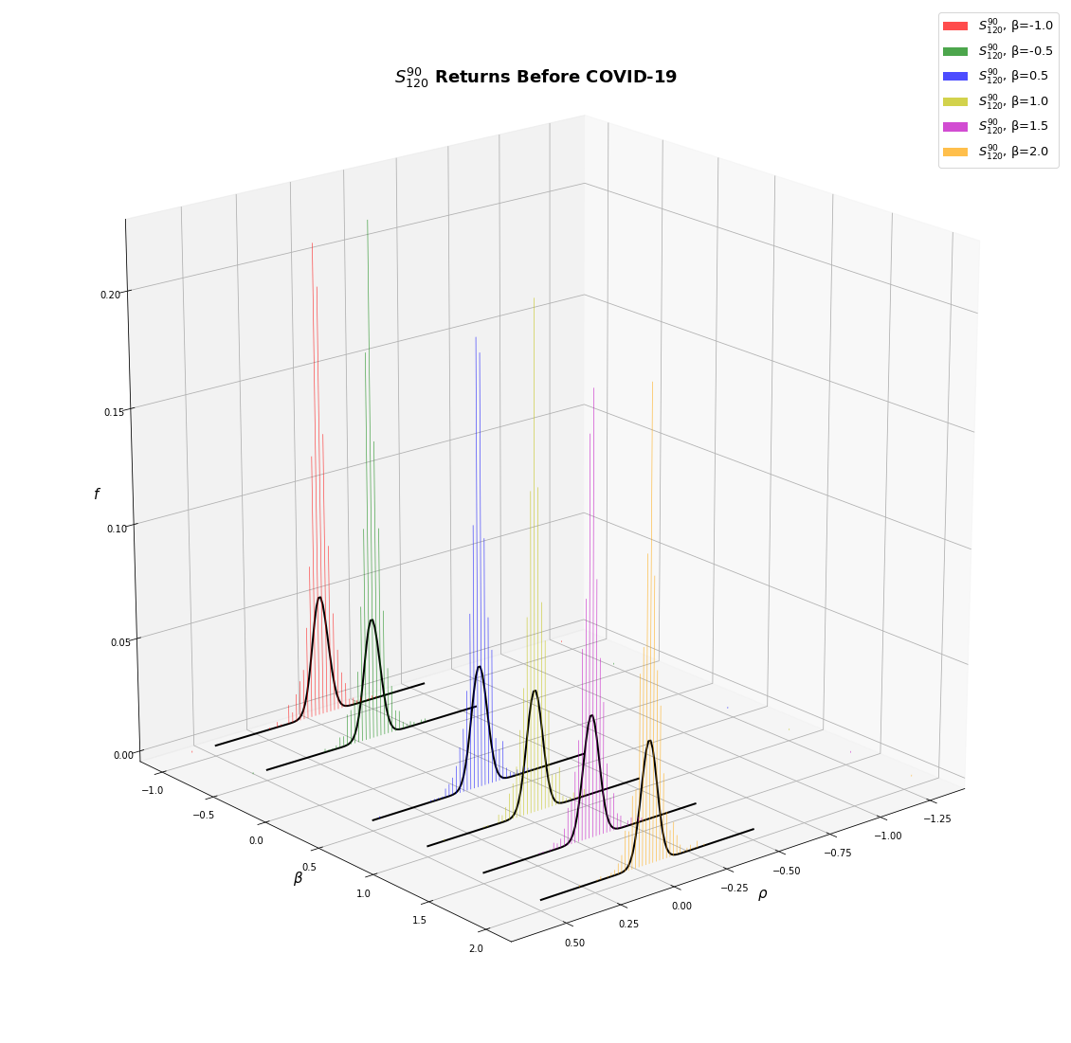
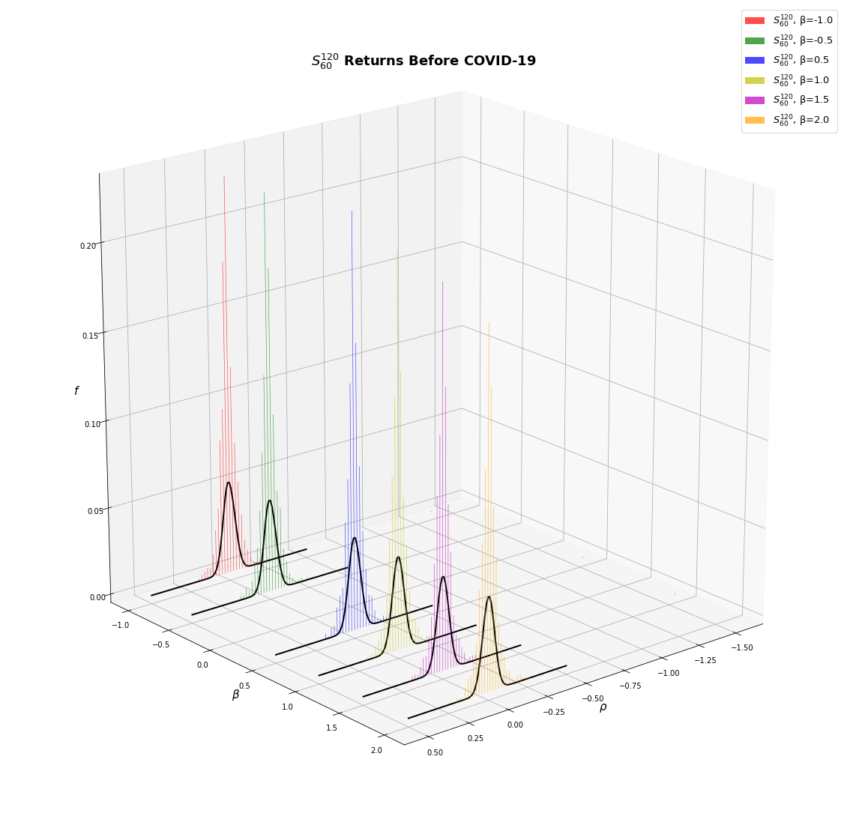
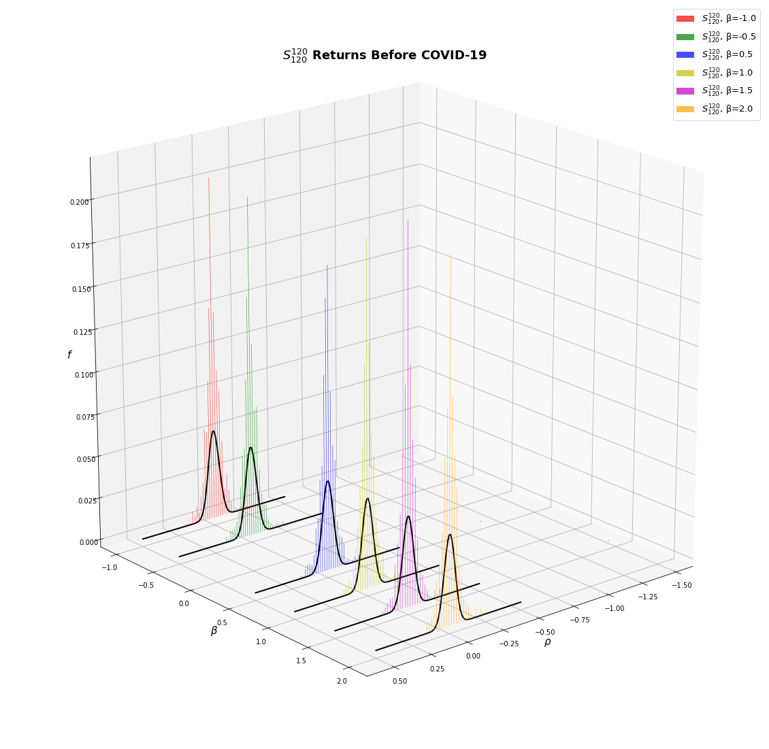

Slide 19
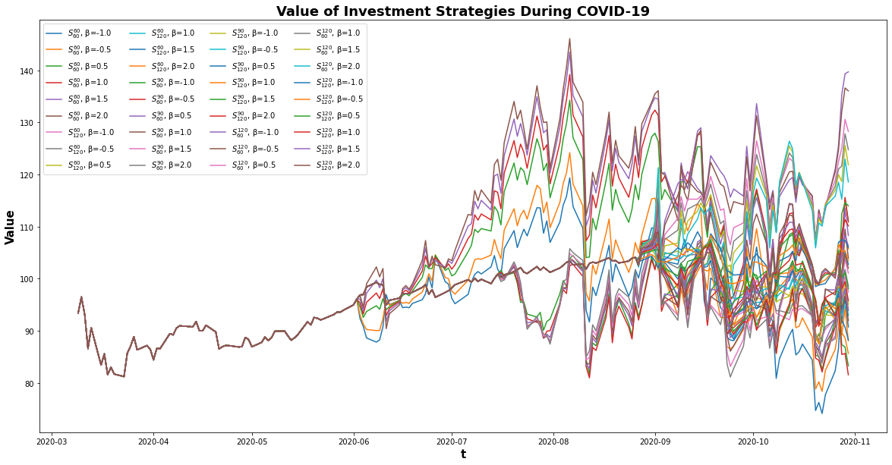

Slide 20
 | S^{60}_{60} | S^{60}_{60} | S^{60}_{60} | S^{60}_{60} | S^{60}_{60} | S^{60}_{60}
 | β = -1.0 | β = -0.5 | β = 0.5 | β = 1.0 | β = 1.5 | β = 2.0
Cumulative Return (Annual) | 1.041899145 | 1.087125637 | 1.172987357 | 1.168001753 | 1.127540151 | 1.060278154
Arithmetic Mean Return (Annual) | 0.240331755 | 0.276763196 | 0.358681199 | 0.366752594 | 0.349975966 | 0.311975903
Geometric Mean Return (Annual) | 0.041048518 | 0.083551142 | 0.159604717 | 0.155342628 | 0.120067225 | 0.058538136
Minimum Return (Annual) | -35.90343875 | -36.72202874 | -38.28023416 | -39.07246013 | -39.86178331 | -40.5601187
Max 10-day Drawdown | -0.237699886 | -0.229337086 | -0.231797355 | -0.250072726 | -0.271701973 | -0.293250135
Volatility | 0.626279825 | 0.616297481 | 0.625828776 | 0.645298121 | 0.673079961 | 0.706537882
Sharpe Ratio (Annual) | 0.287941184 | 0.351718452 | 0.477257056 | 0.475365701 | 0.430819491 | 0.356634668
Kurtosis (Annual) | 2.01029752 | 1.74328629 | 1.280176574 | 1.058690717 | 0.904508114 | 0.902851883
Skew (Annual) | -0.508998364 | -0.581595011 | -0.564820723 | -0.505594858 | -0.462955639 | -0.438913216
mVaR (Annual) | -107.7097597 | -107.2505628 | -108.7273024 | -111.4081878 | -115.8564144 | -121.5141174
VaR (Daily) | -6.419036128 | -6.30061755 | -6.367004102 | -6.566314513 | -6.862038748 | -7.22530044
VaR (Annual) | -101.4938727 | -99.62151062 | -100.6711742 | -103.8225485 | -108.4983592 | -114.2420309
CVaR (Annual) | -156.3241663 | -153.1822187 | -149.8899093 | -149.5382186 | -152.9183858 | -162.7805688

Slide 21
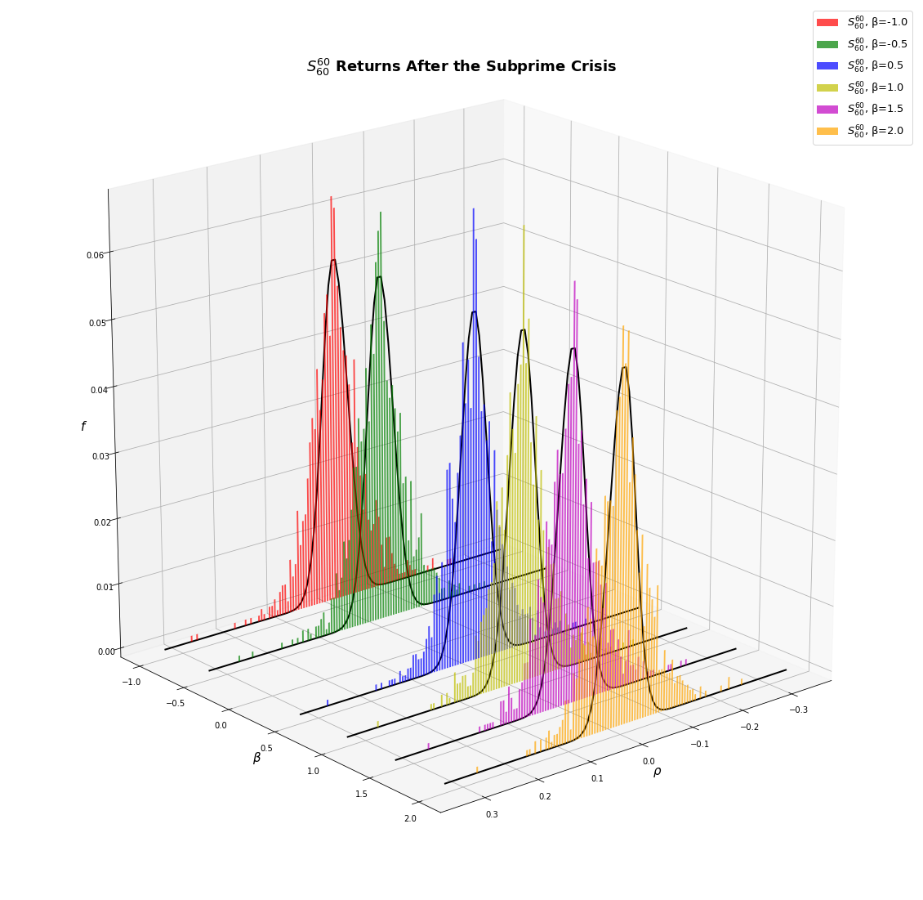
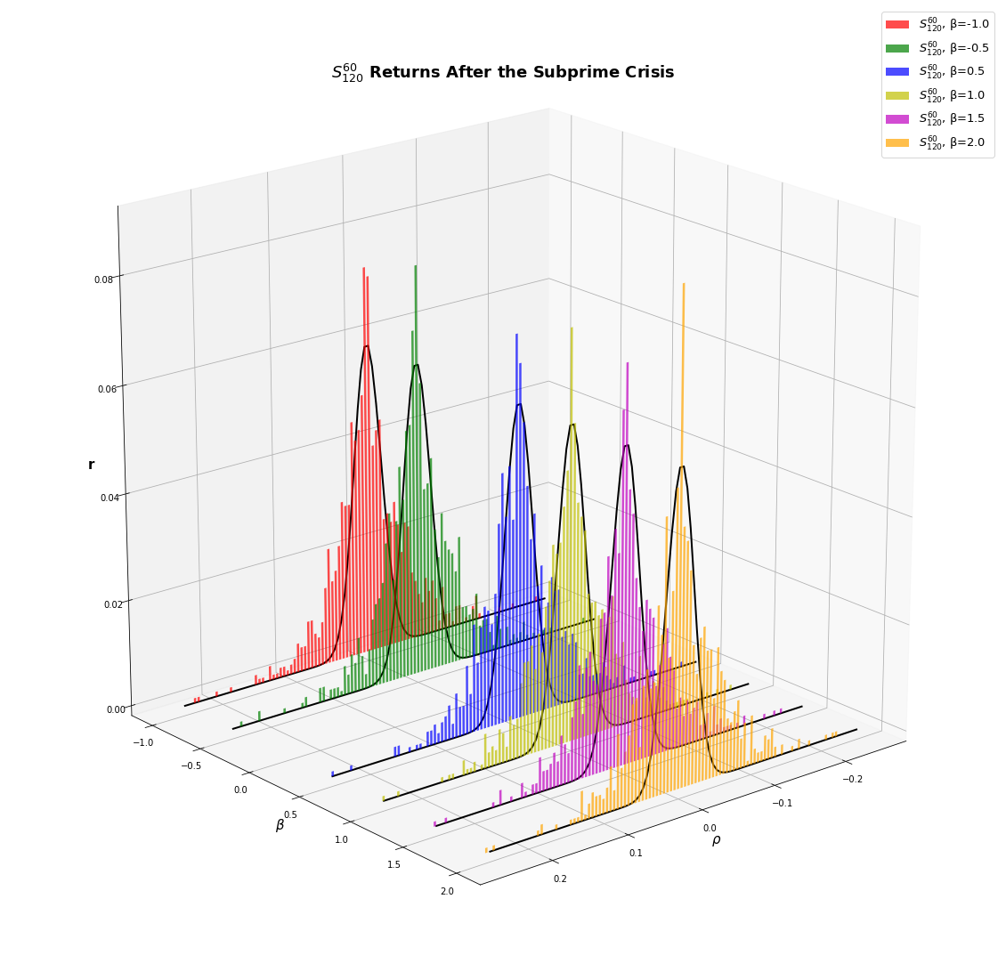
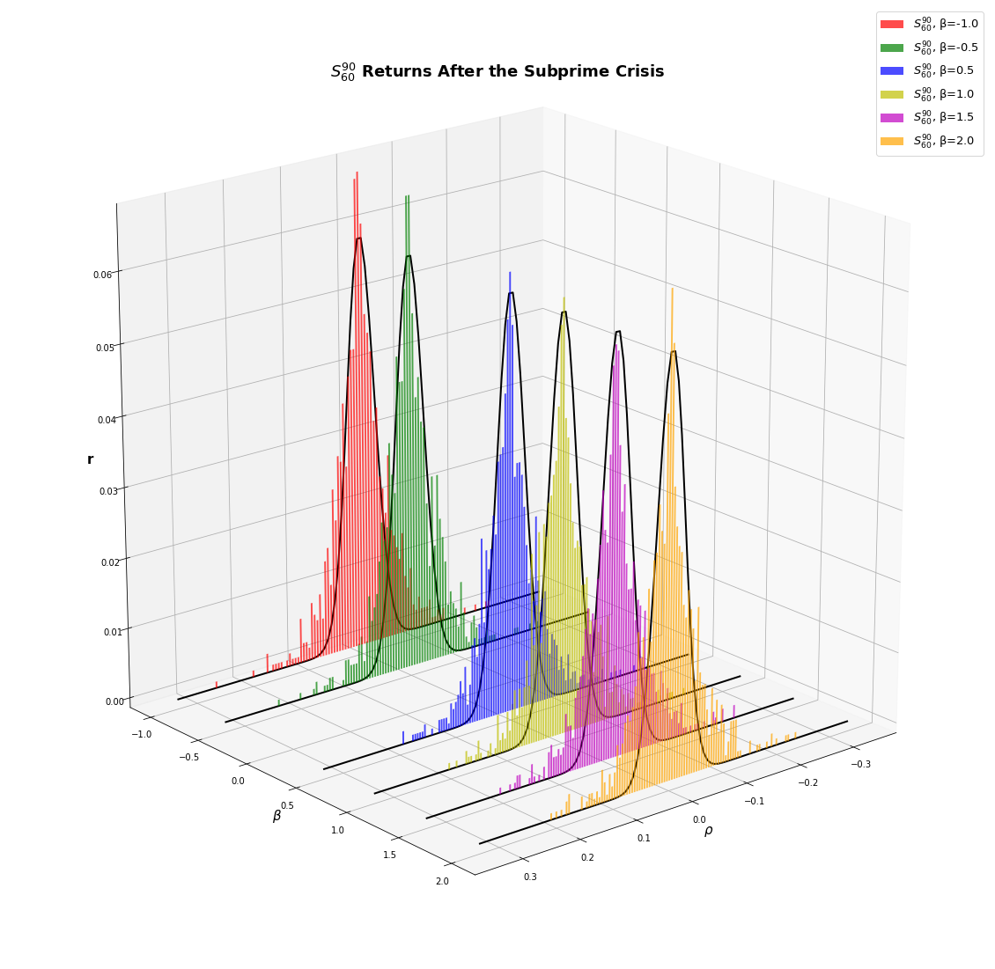
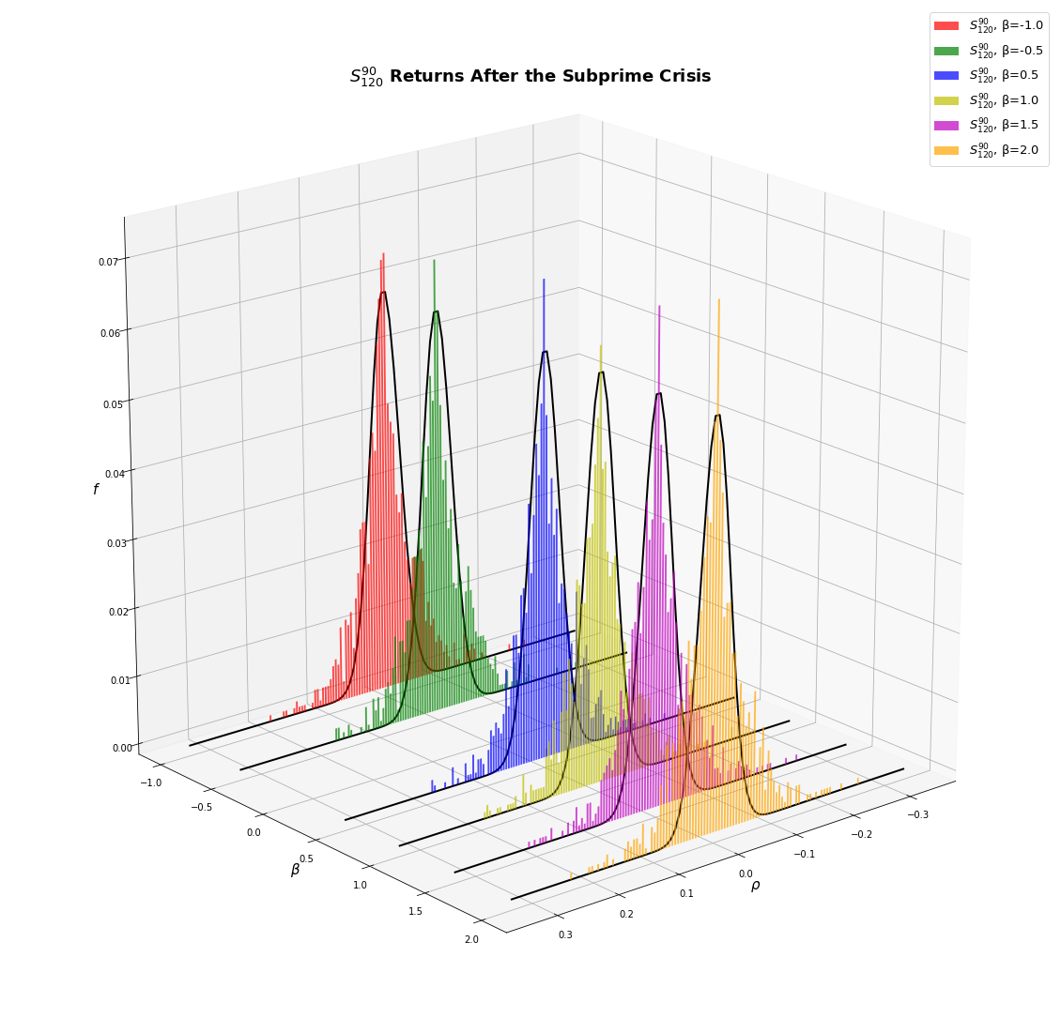
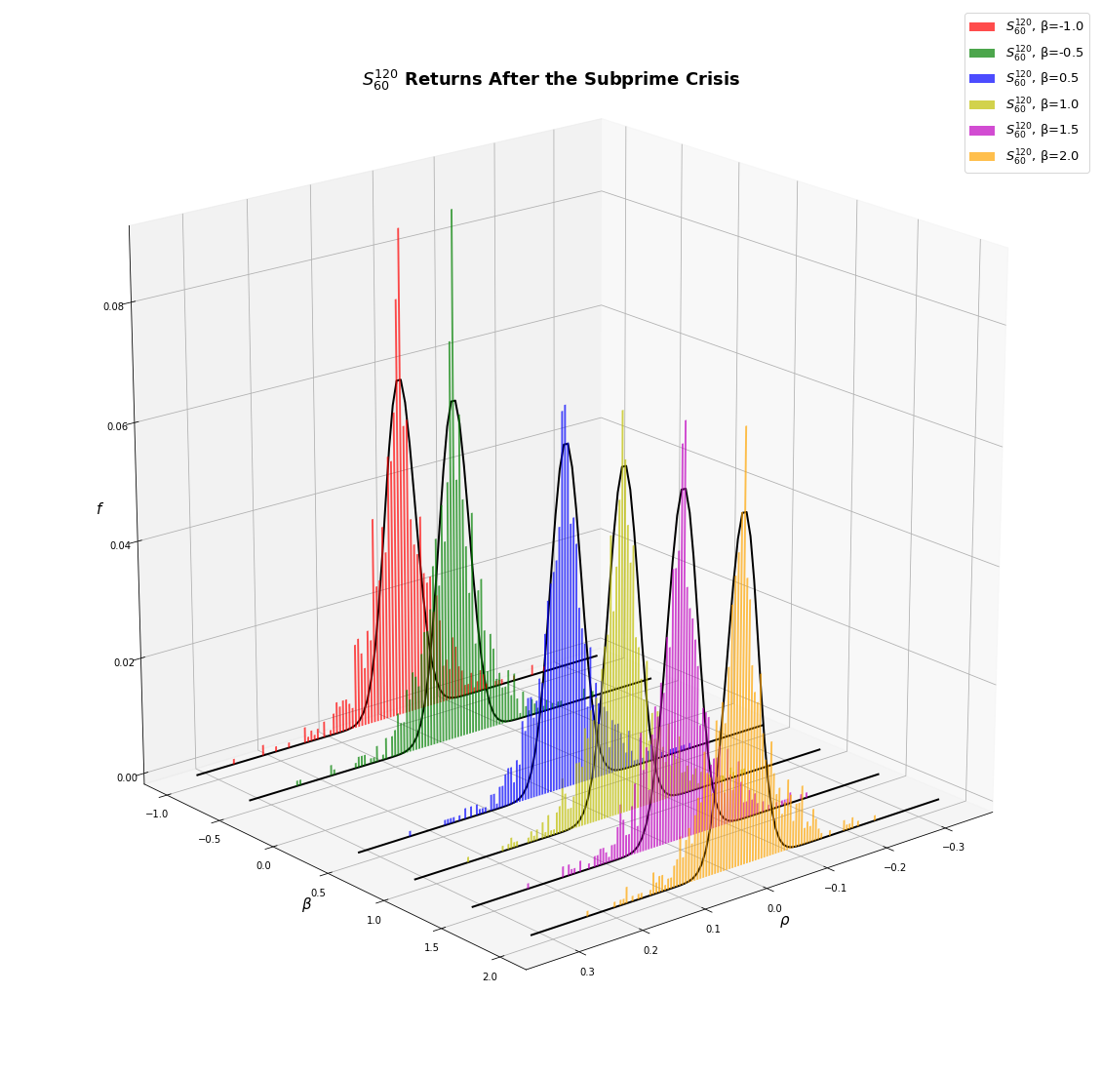
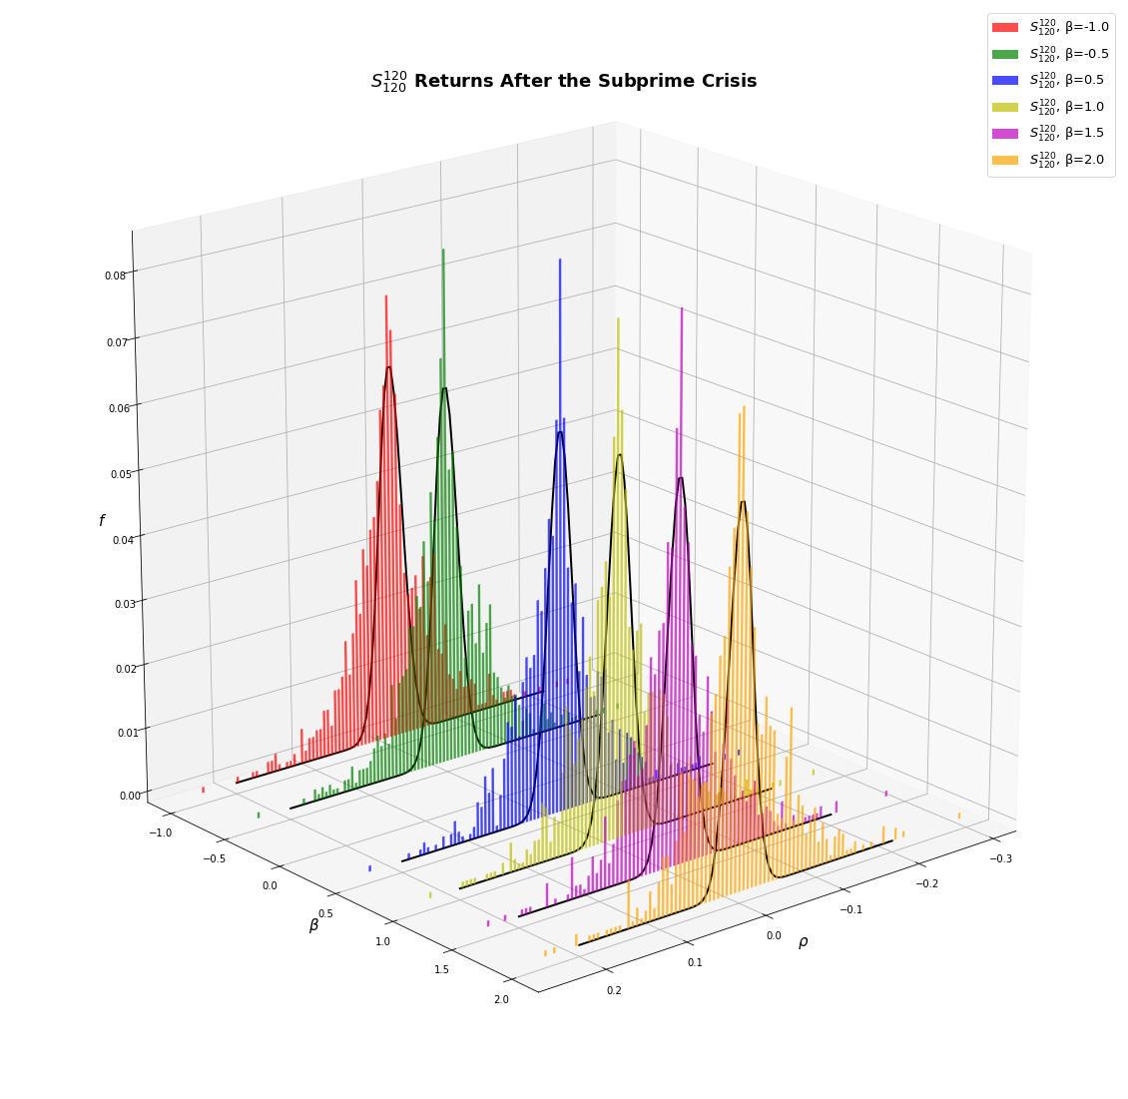

Slide 22
Results & Discussion
Top Performers:
Pre-Housing Crisis, S^120_120(β = 0.5): low drawdown and large Sharpe Ratio.
During the Subprime Crisis, S^120_120(β = 2): highest return and low volatility.
Post-Housing Crisis, S^60_60(β = 2): largest Sharpe ratio and highest cumulative return
In the period before COVID-19, S^60_120(β = 1.5): highest return with the lowest volatility.
During COVID-19, S^90_120(β = -1.0) was the best performer (The target beta is to be expected, as a fully de-correlated portfolio performs better than the market when the latter is under stress).
Conclusion:
Portfolio sensitivity to beta terms: not a clear relationship,
Returns have a significant relationship to the estimation terms,
Term structure also plays an important role, but less so than the estimation terms,
The first day of each lookback period affects strategy returns.

